Slide 1
UE21CS320A – Capstone Project Phase-1 Review #3
(High Level Design and Proposed Methodology)
Project Title : Indexing and Summarization of Sports
Videos using Multi-Modal Approach
Project ID : 61
Project Guide : Dr. Sandesh B J
Project Team : PES2UG21CS242 (Krupashree M V)
PES2UG21CS289 (Meenal Bagare)
PES2UG21CS294 (Melvin Jojee Joseph)
PES2UG21CS324 (Naveen Kumar Reddy G)

Slide 2
Outline
Abstract
Summary of Literature Survey
Suggestions from Review – 2
Proposed Methodology / Design Approach
Architecture
Design Description
Technologies Used
Project Progress
References

Slide 3
Abstract
The current process of sports summarization relies heavily on manual efforts. Large editing teams manually review entire game footage, select crucial moments, and compile highlights.
This process is not only time-consuming but also resource-intensive, leading to potential uneven coverage of events.
Our project addresses this challenge by proposing a multi-modal approach, leveraging the power of Twitter data, audio features, and video content to automate and enhance the summarization process

Slide 4
Summary of Literature Survey in Review 2
Research paper encompasses various approaches to video summarization and event detection across different sports, including baseball, soccer, cricket, and others.
Innovation techniques such as Multimodal Variational Autoencoder(Tl-MVAE), machine learning (YOLO v3 and OpenPose), LSTM with attention mechanism show promising result in accurately summarizing key event in sports video.
Challenges addressed include time-lags between events and tweets,enhance accuracy of action recognition and event detection in various sporting event.
Challenges in video summarization include data dependency, potential error in event detection,depend on data quality, and dependency on keyword frequency in text stream analysis.
These research papers collectively offer valuable insights into enhancing summarization accuracy, efficiency, and scalability in sports video analysis,highlighting areas for further exploration and improvement.

Slide 5
Summary of Literature Survey in Review 2
Citation: Hirasawa K, Maeda K, Ogawa T, Haseyama M. Detection of Important Scenes in Baseball Videos via a Time-Lag-Aware Multimodal Variational Autoencoder. Sensors (Basel). 2021 Mar 14;21(6):2045. doi: 10.3390/s21062045. PMID: 33799412; PMCID: PMC7999231.
Objective: The objective of the paper is to propose a method for the detection of important scenes in baseball videos via the MVAE considering time-lags between tweets and corresponding multiple previous events.The Tl-MVAE consists of an encoder, decoder and an important scene detector. The paper uses Poisson distribution to account for time-lags.
Advantages: Tl-MVAE can correctly consider the relationships between tweets and videos.Experimental results confirmed that the Tl-MVAE realizes the accurate detection of important scenes of baseball videos. Since the immediately previous event strongly influences the tweet and the influence of past events tends to be gradually weakened, the paper adopts Poisson distribution for the consideration of time-lags.
Limitations: The performance of the proposed method could be sensitive to the choice of Poisson distribution parameters. Finding the optimal values for these parameters might be challenging. Also, the proposed model involves complex mathematical models and neural networks which might require significant computational resources for training.

Slide 6
Summary of Literature Survey in Review 2
Citation: A. Javed, K. B. Bajwa, H. Malik and A. Irtaza, "An Efficient Framework for Automatic Highlights Generation from Sports Videos," in IEEE Signal Processing Letters, vol. 23, no. 7, pp. 954-958, July 2016, doi: 10.1109/LSP.2016.2573042
Objective: The objective of the paper you provided is to propose a method for automatic highlight generation from sports videos through the detection of replay segments (RSs). The paper aims to exploit two observations for replay detection.
Advantages:
The proposed system is evaluated on a diverse dataset comprising videos from different sports categories and broadcasters, indicating its potential applicability across various sports and broadcasting styles.
Limitations:
OCR Accuracy: The effectiveness of SC detection using OCR depends on the accuracy of the OCR algorithm and the quality of the input images. Errors in OCR recognition could lead to mislabeling of frames, impacting the overall performance of the system

Slide 7
Summary of Literature Survey in Review 2
Citation: H. Sattar, M. S. Umar, E. Ijaz and M. U. Arshad, "Multi-Modal Architecture for Cricket Highlights Generation: Using Computer Vision and Large Language Model," 2023 17th International Conference on Open Source Systems and Technologies (ICOSST), 2023, pp. 1-6, doi: 10.1109/ICOSST60641.2023.10414235
Objective: The objective of this paper is to leverage large language models to aid in the generation of sports summaries. The approach mentioned in this paper used the YOLO model in order to split the video into 20 second segments based on the bowler’s position and later feeds the commentary data into a large model that is trained to identify events based on words used for each event.
Advantages: The approach used in this paper has an accuracy of roughly 97% which has been achieved due to large corpus of words that has been identified for each type of event. The use of a BERT that has been fine tuned for English commentary data has also aided in achieving such high level of accuracy.
Limitations: Misclassifications occur when the commentators describe the game’s bigger picture, separate from the actual ball action, such as boundaries and wickets. There are also times when ball actions come to an abrupt end, which causes a discrepancy between the extracted comments and the real event sequence. The commentary’s temporal misalignment separates the model’s narrative depiction from the real event.

Slide 8
Summary of Literature Survey in Review 2
Citation: Z. Saeed, R. Ayaz Abbasi, M. I. Razzak and G. Xu, "Event Detection in Twitter Stream Using Weighted Dynamic Heartbeat Graph Approach [Application Notes]," in IEEE Computational Intelligence Magazine, vol. 14, no. 3, pp. 29-38, Aug. 2019, doi: 10.1109/MCI.2019.2919395
Objective: Weighted dynamic heartbeat graph for detecting event in a dynamic text stream like social media data like twitter, Weighted Dynamic Heartbeat Graphs (WDHG) capture evolving word usage over time. Key features, Growth Factor (GF) and Aggregated Centrality (AC), enabling the detection of significant events by classifying and ranking strong snapshots.
Advantages: WDHG efficiently detects and highlights emerging topics in dynamic text streams.
suitable for processing large volumes of Twitter data in real-time event detection scenarios.
Limitations:Dependency on Keyword Frequency: The method heavily relies on keyword frequency, which may lead to biased results, especially in noisy or diverse text streams. The approach may face challenges in handling bursty events where topics rapidly gain popularity and decline.

Slide 9
Suggestions from Review – 2
From the literature survey done during review-2 we were suggested to use:
Language Models: Utilization of Large Language Models (LLM) to identify events from commentary data.
Replay Analysis : Analyze replays within sports videos for key actions.
Time lag consideration : Accounting for time lag between Twitter data and video content using Poisson Distribution.
Weighted Graph Model : Implement a weighted graph model to prioritize events that are significant but not caught.
Progress has been made in meticulous planning regarding the selection of appropriate models and technologies to be used.

Slide 10
Proposed Methodology / Approach
Basic Approach and Results Obtained:
Basic Approach: The basic approach involved traditional methods of sports video summarization, primarily relying on video content analysis to identify key events. This approach might include techniques such as shot boundary detection, scoreboard analysis, and player tracking to extract highlights.
Results Obtained: The basic approach likely yielded satisfactory results in terms of summarizing sports videos to some extent. However, it has some limitations in capturing the broader context of the game, including audience reactions and social media buzz surrounding the event.

Slide 11
Proposed Methodology / Approach
2. Is There a Need for Changing the Approach?:
Yes, there is a need for changing the approach. The basic approach, while effective to some extent, lacks the ability to capture the audience engagement and social media discussions related to the game. Additionally, it might not fully utilize advancements in AI and natural language processing for deeper analysis of audio, visual, and textual content.

Slide 12
Proposed Methodology / Approach
3. Details of the New Approach - Benefits:
New Approach: The new approach integrates Twitter data analysis with advanced audio and visual processing techniques to enhance sports video summarization.
Benefits:
Audience Engagement: Incorporating Twitter data allows for capturing audience reactions, sentiments, and discussions related to the game, providing valuable context to the summarization process.
In depth Analysis: By combining multiple modalities such as audio, visual, and textual data, the new approach offers a more comprehensive understanding of the game events, enhancing the quality and relevance of the summaries.

Slide 13
Proposed Methodology / Approach
3. Details of the New Approach - Drawbacks:
Data Volume and Noise: Handling the vast volume of Twitter data and filtering out noise or irrelevant tweets can be challenging.
Time Discrepancies Among Modalities: Time discrepancies among modalities may lead to synchronization challenges, affecting the coherence and accuracy of the generated summaries.
Complexity: Integrating multiple data sources and processing techniques adds complexity to the system.
Computational Resources: Advanced audio and visual processing techniques may require significant computational resources and processing time

Slide 14
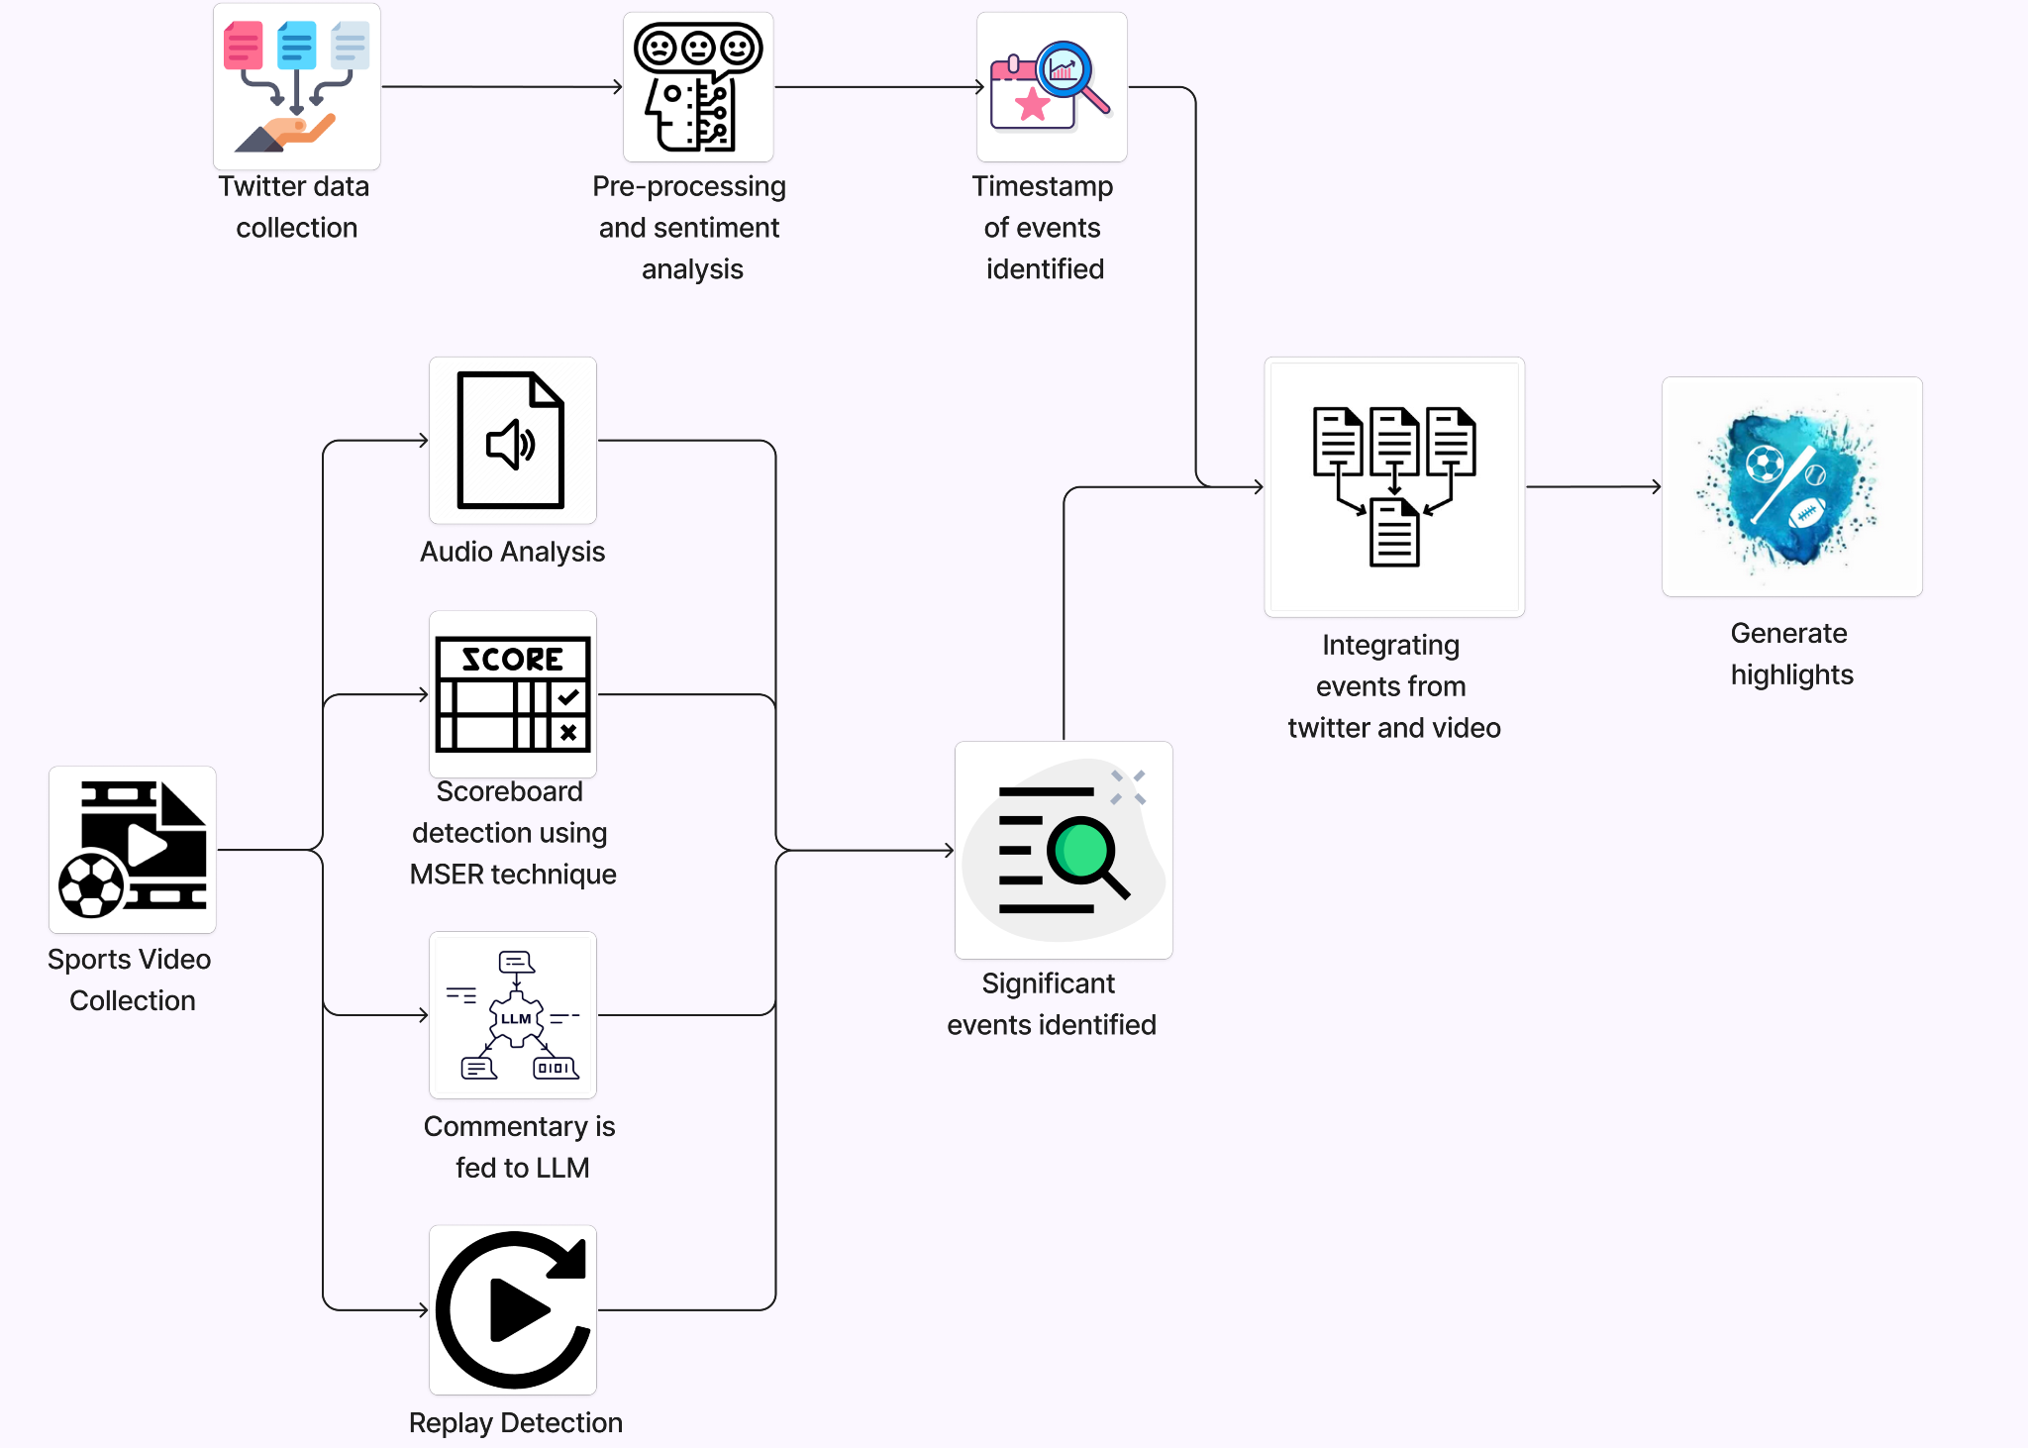

Slide 15
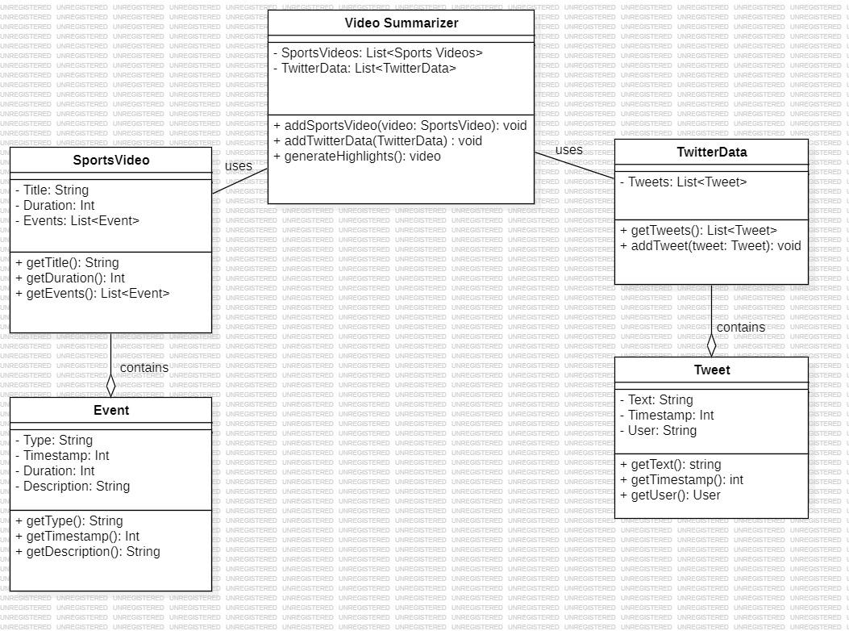
Design Description (if applicable)
Master class diagram

Slide 16
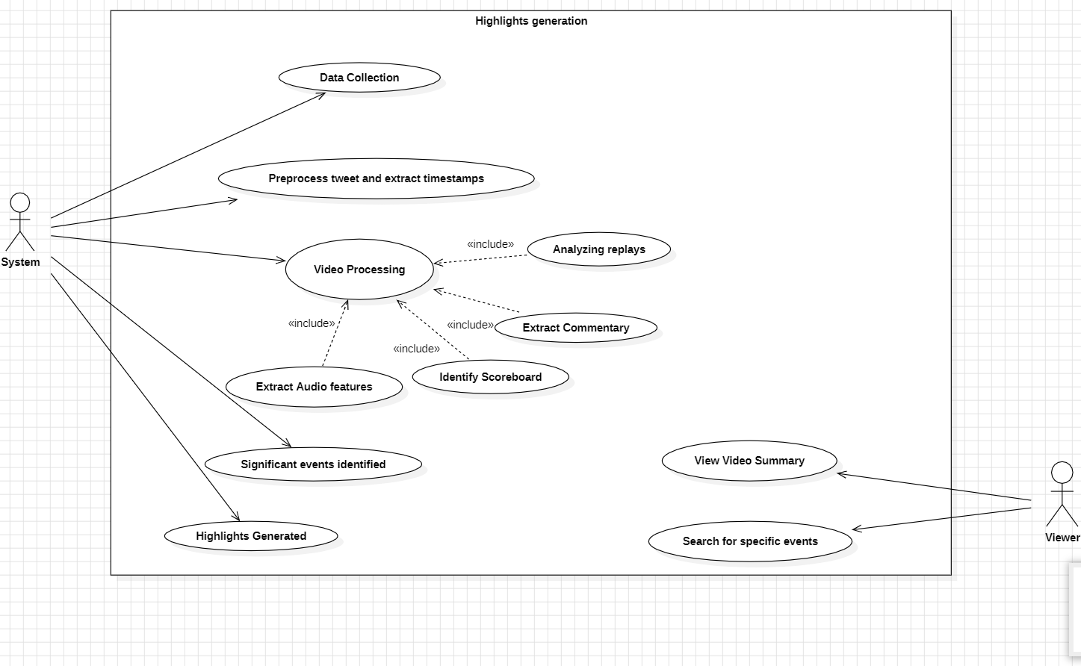
Design Description (if applicable)
Use case diagram

Slide 17
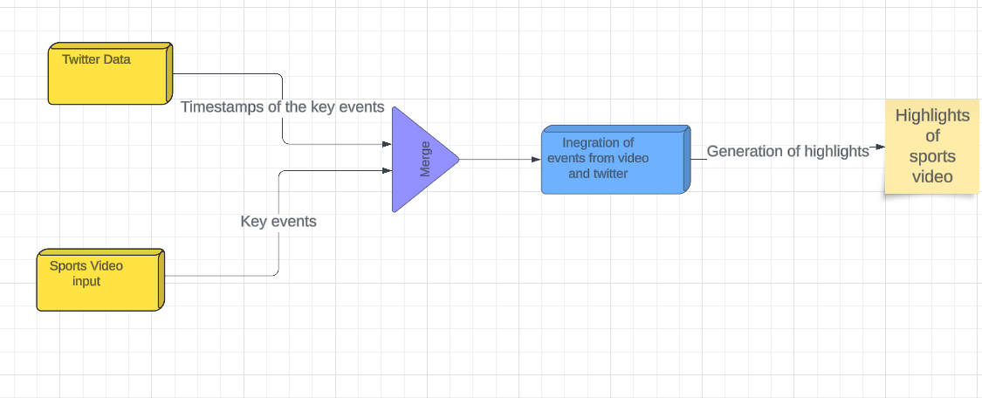
Design Description (if applicable)
External Interfaces

Slide 18



Technologies Used
OpenCV: Used for video processing tasks such as extracting frames, detecting scoreboard, and analyzing visual content.
Python: The primary programming language for implementing the project. Python has a wide range of support for various machine learning and computer vision libraries.
TensorFlow: Deep learning frameworks for implementing advanced models such as neural networks for audio and visual analysis, as well as integrating pre-trained models like OpenAI's whisper model for audio transcription.

Slide 19
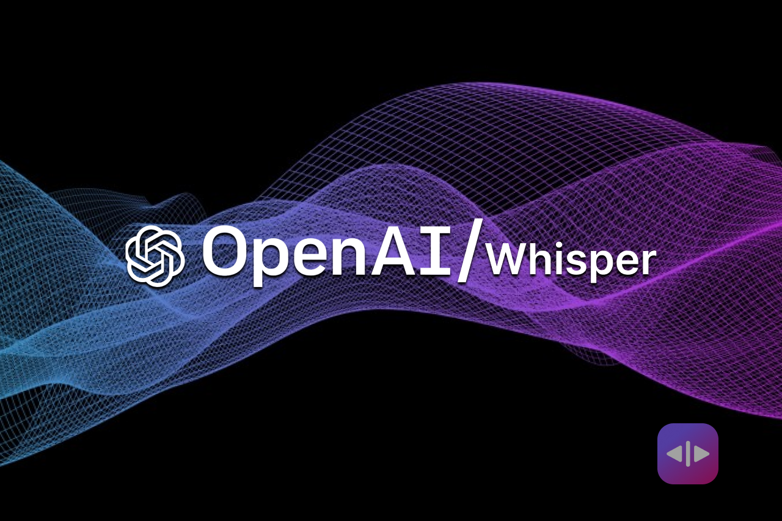

Technologies Used
OpenAI’s Whisper model employs speech recognition algorithms to transcribe commentator speech or audio commentary from the sports event into text.
Google Bert, an open source large language model that will identify events by going through the commentary data of the sports video.

Slide 20
Project Progress
What is the project progress so far?
As of now, the project progress includes the formulation of a comprehensive problem statement, completion of extensive literature survey, development of an architecture diagram outlining the system’s structure and meticulous planning regarding the selection of appropriate models and technologies to be used.
What is the percentage completion of the project?
40%

Slide 21
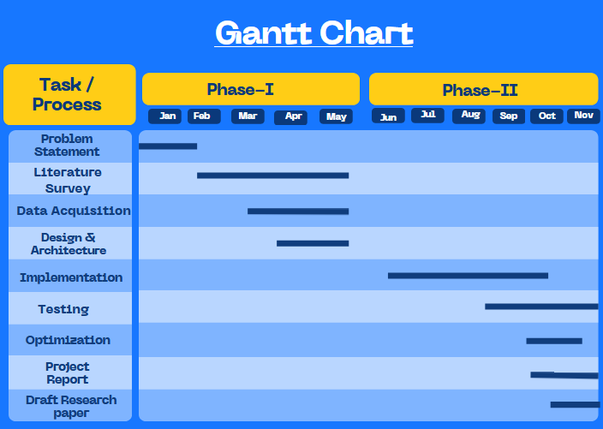
Capstone (Phase-I & Phase-II) Project Timeline

Slide 22
Conclusion
The Automated Sports Summarization System addresses the time constraints and labor-intensive nature of manual summarization methods for sports highlights.
We use twitter data analysis, video and audio processing, and advanced techniques like MSER (Maximally Stable Extremal Regions)-based scoreboard identification, it efficiently generates concise yet comprehensive summaries of sports events.
By incorporating Large language model (LLM) and computer vision, the system enhances event matching and scene classification and we use weighted dynamic heartbeat graph in order to find new emerging event from tweets and multimodal variational autoencoder(Tl-MVAE).

Slide 23
References
Hirasawa K, Maeda K, Ogawa T, Haseyama M. Detection of Important Scenes in Baseball Videos via a Time-Lag-Aware Multimodal Variational Autoencoder. Sensors (Basel). 2021 Mar 14;21(6):2045. doi: 10.3390/s21062045. PMID: 33799412; PMCID: PMC7999231.
A. Javed, K. B. Bajwa, H. Malik and A. Irtaza, "An Efficient Framework for Automatic Highlights Generation from Sports Videos," in IEEE Signal Processing Letters, vol. 23, no. 7, pp. 954-958, July 2016, doi: 10.1109/LSP.2016.2573042
H. Sattar, M. S. Umar, E. Ijaz and M. U. Arshad, "Multi-Modal Architecture for Cricket Highlights Generation: Using Computer Vision and Large Language Model," 2023 17th International Conference on Open Source Systems and Technologies (ICOSST), 2023, pp. 1-6, doi: 10.1109/ICOSST60641.2023.10414235
Z. Saeed, R. Ayaz Abbasi, M. I. Razzak and G. Xu, "Event Detection in Twitter Stream Using Weighted Dynamic Heartbeat Graph Approach [Application Notes]," in IEEE Computational Intelligence Magazine, vol. 14, no. 3, pp. 29-38, Aug. 2019, doi: 10.1109/MCI.2019.2919395

Slide 24
Thank You

